Slide 1

DEPARTMENT OF COMPUTER SCIENCE AND ENGINEERING
Professional Training I
Real Estate Sales and Property Analysis
PROJECT STUDENT GUIDE
SAI MONISHA.M, 44111001 Dr. M. MAHASREE

Slide 2
AGENDA
Certificate
Abstract
Introduction
Objective
System Architecture / Ideation Map
Module Implementation
Results and Discussions
Conclusion
References

Slide 3
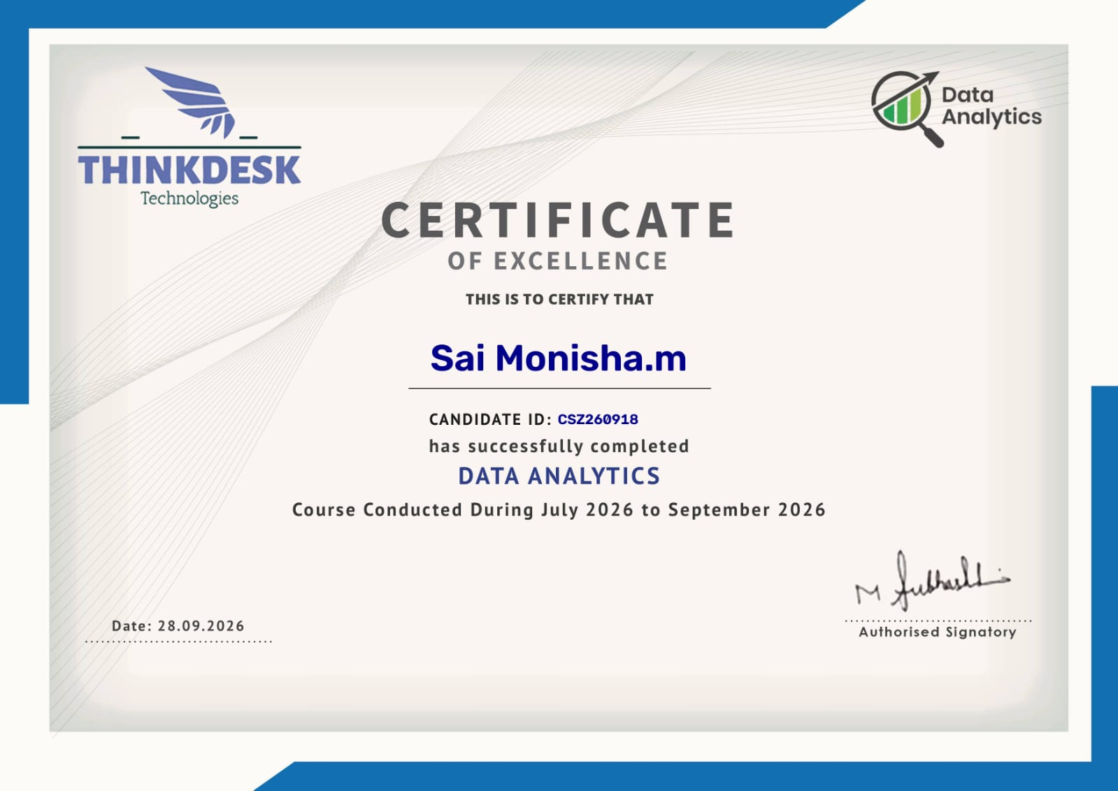
COURSE CERTIFICATE

Slide 4
ABSTRACT
The Real Estate Sales and Property Analysis using Power BI project focuses on analyzing real estate sales data to identify important trends and patterns. The system uses Power BI to visualize property sales based on location, property type, price range, and time period. Interactive dashboards, KPI cards, charts, and filters provide insights into total sales, revenue, average property price, monthly trends, and top-performing locations. The dashboard converts raw data into meaningful visual information, helping users understand market performance and supporting data-driven real estate planning and analysis.

Slide 5
INTRODUCTION
The real estate industry generates a large amount of data related to property sales, locations, property types, prices, customers, and revenue. Analyzing this data manually can be time-consuming and may make it difficult to identify important sales trends and high-performing locations. This project, Real Estate Sales & Property Analysis using Power BI, focuses on developing an interactive dashboard that converts real estate sales data into meaningful visual insights.
The Power BI dashboard analyzes property sales based on location, property type, price range, and time period. It provides visual representations of total sales, monthly revenue, property distribution, and top-performing locations. Interactive filters allow users to analyze specific cities, property categories, and price ranges. The dashboard also uses Key Performance Indicators (KPIs) to provide a quick overview of important business metrics. By presenting the information in an easy-to-understand format, the system helps users identify market patterns and supports data-driven real estate business and investment analysis.

Slide 6
OBJECTIVES
The main objectives of the project are:
To develop an interactive Real Estate Sales Dashboard using Power BI.
To analyze property sales based on location, property type, and price range.
To track monthly sales and revenue trends.
To identify top-performing cities and locations.
To categorize properties according to different price ranges.
To provide interactive filters for city, property type, and price category.
To create KPIs for important metrics such as total properties sold, total revenue, and average property price.
To provide detailed visual insights that can support real estate business planning and investment analysis.
To reduce the effort required for manual analysis of real estate sales data.
To present complex sales information through simple and interactive visualizations.
3. System Architecture / Ideation Map
The proposed system follows a data-processing and visualization architecture in which raw real estate data is transformed into meaningful information through Power BI.

Slide 7
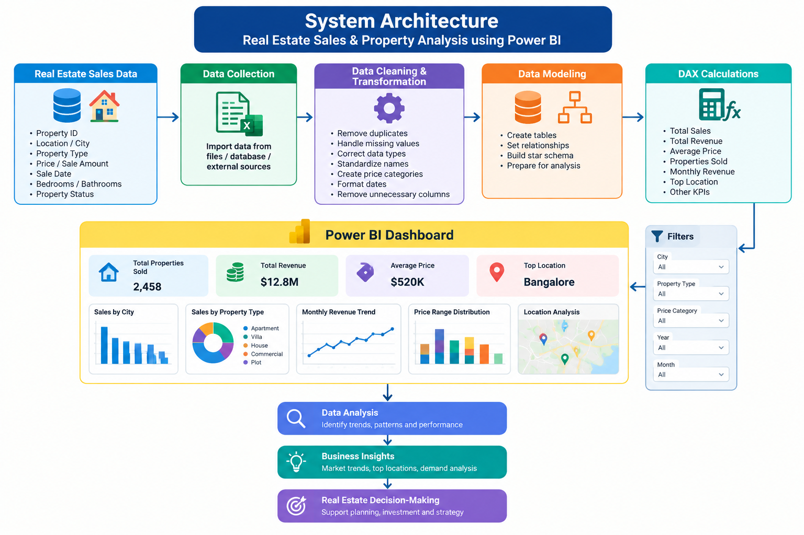
SYSTEM ARCHITECTURE

Slide 8
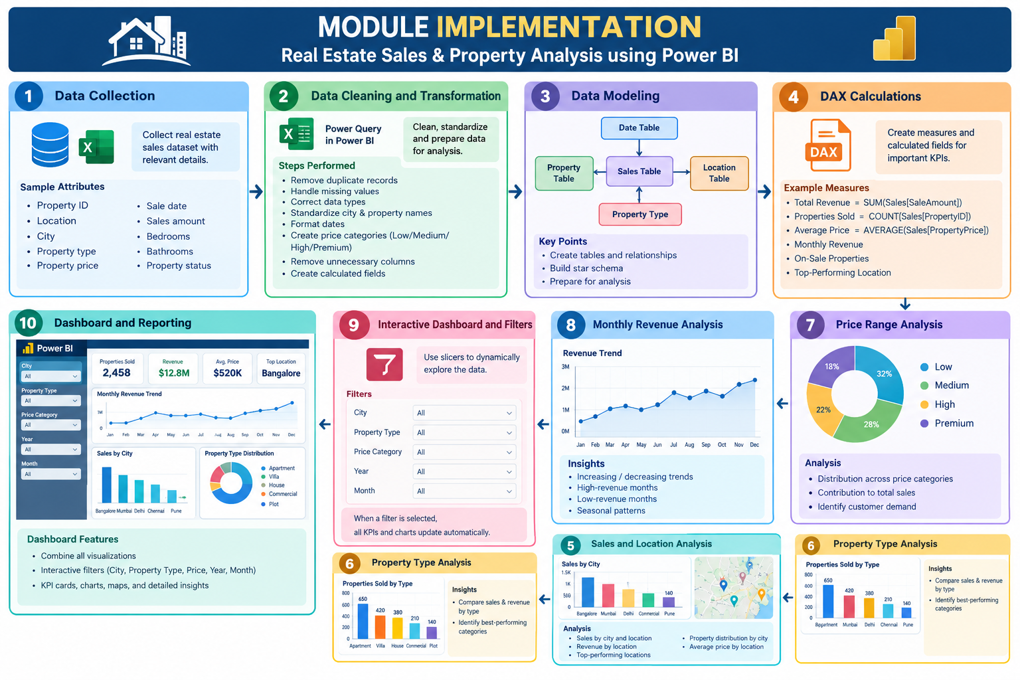
MODULE IMPLEMENTATION

Slide 9
RESULTS AND DISCUSSIONS
The developed Power BI dashboard provides an interactive platform for analyzing real estate sales data. The dashboard presents important information through KPI cards, charts, graphs, and filters, allowing users to understand the overall performance of the property market represented by the dataset.
The analysis provides information about the total number of properties sold, total revenue generated, average property price, monthly revenue trends, and location-wise sales performance. The location analysis helps identify areas with higher sales activity, while property-type analysis shows the distribution of sales across different categories.
The price-range analysis provides insights into the distribution of properties across different price categories. Monthly revenue visualization helps users observe changes in sales performance over time. Interactive filters further improve the usability of the dashboard by allowing users to focus on specific cities, property types, price ranges, or periods.
Overall, the dashboard converts raw sales data into an easily understandable visual format. These insights can assist real estate organizations in monitoring sales performance, identifying market patterns, and supporting data-driven planning. Investment decisions should, however, consider additional factors beyond the dashboard, such as market conditions, property-specific risks, financing costs, and legal considerations.

Slide 10
CONCLUSION AND FUTURE SCOPE
The Real Estate Sales & Property Analysis using Power BI project demonstrates how Business Intelligence and data visualization can be applied to real estate sales data. The developed dashboard provides an interactive method for analyzing property sales according to location, property type, price range, and time.
Power BI simplifies the process of converting raw data into useful information through data cleaning, modeling, DAX calculations, KPIs, charts, and interactive filters. The dashboard helps users monitor revenue, identify high-performing locations, compare property categories, and understand sales trends.
The project successfully demonstrates the usefulness of Power BI for real estate data analysis and business reporting. The system can be further enhanced by incorporating additional datasets such as property valuation, customer demographics, rental yields, geographic factors, and historical market data to provide a broader analytical view.

Slide 11
REFERENCES
Microsoft, Power BI Documentation, Microsoft Learn. Microsoft Power BI Documentation
Microsoft, Power Query Documentation, Microsoft Learn. Power Query Documentation
Microsoft, DAX Documentation, Microsoft Learn. DAX Documentation
Microsoft, Power BI Data Modeling Documentation, Microsoft Learn. Power BI Data Modeling
Microsoft, Power BI Visualizations Documentation, Microsoft Learn. Power BI Visualizations

Slide 12
THANK YOU
We thank God, Our Department, Guide, Panel Members, Supportive Professors and all Technical and non Technical staff who helped us in our Project.

